Slide 1

Introduction to classification models
Hindol Basu
Tata iQ
The information contained in the document is proprietary to Tata Industries Limited- Tata Insights & Quants Division and is strictly confidential. In consideration of receipt of this document, the recipient agrees that the information is being shared only for the limited purpose. The recipient of this information further agrees to maintain such information in confidence and to not reproduce, disclose, duplicate, electronically transmit or use in whole or in part for any other purpose. Prior written consent shall be obtained from the Insights & Quants Division of Tata Industries in case the information is necessitated to be shared with anyone other than the Recipient to whom this information is addressed. The above restriction shall not limit the right to use the information contained in this deck, if it is obtained from another source without restriction.
© Copyright, Tata Insights & Quants Division, Tata Industries Limited

Slide 2
What are we trying to achieve in this session
Understand what we mean by classification algorithms and why they are important?
Get our hands dirty and try to evaluate a classification model – we will try to answer the question “how good is my classification model?” without going into the details of how we can build one
Learn the types of classification algorithms
We all talk about complex machine learning algorithms. Are they really worth all the complexity?
Analytical challenges – what are some of the typical challenges that we may face while developing a classification model
A more comprehensive view on “how good is my classification model?”

Slide 3

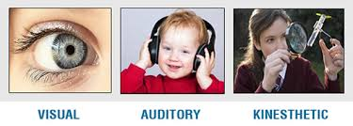

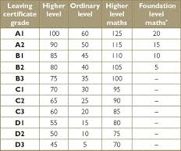

Basic classification problem types – what are we trying to solve?
As a teacher you may want to understand your students in different ways - you may want to know their preferred learning styles so that you can teach them accordingly. You may also want to know who may become a “future doctor”, a “future scientist” etc.
Visual
Future career
Auditory
Identification of distinct groups or classes. So that each group is distinct with respect to one or more dimensions
Prediction of future state or prediction of level of a future phenomena
Future level of proficiency
Kinaesthetic

Slide 4

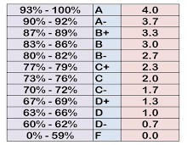
Criticality of classification problems – why are we trying to solve these problems?
Classification is possibly the most widely used technique – based on the availability of an objective function and the requirement of predicting future states, we use either a supervised or un-supervised method
Segmentation
Distinct groups of customer, suppliers, employees etc. that needs to be treated differently
More often than not, we do not know the extract criteria or criterion based on which the distinctness needs to be established
Use supervised or unsupervised approaches
Prediction = Classification
Most business problems tend to involve a prediction of future state
Most point predictions tend to be inaccurate – a data scientist’s solution is to convert them into prediction of future classes (classification saves our reputation & our jobs): convert a continuous outcome to a High, Medium, Low
Use supervised approaches

Slide 5
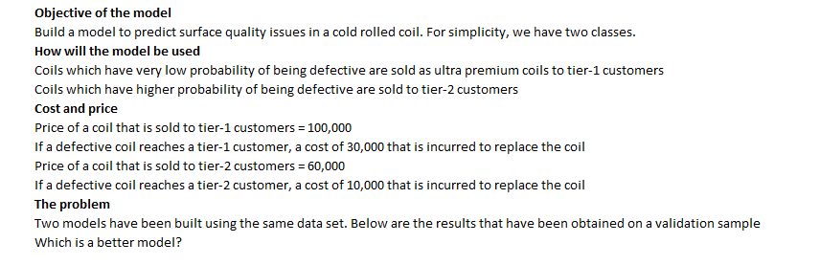
I have a classification model – how do I know that it is useful?: lets get our hands dirty
All models are wrong but some are still useful

Slide 6
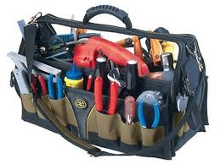
The available tools – what are the tools that we have at our disposal?
A data scientist should know the classification tools in her kitty and keep them ready to handle the appropriate analytical challenge
Regression Based
Clustering Based
Tree Based
Machine Learning: Ensemble Based
Unsupervised
Supervised
Similarity Based
Machine Learning: Combination Based
Machine Learning: Latent Class Based
Boltzmann machine and other Deep Learning
Based on Outlier Detection
Dimensionality Reduction

Slide 7
Are complex methods necessarily better?
Interaction effects are the major driver for adopting more complex methods
Approximately Linear
Non Linear
Interaction
Where var2>a
Outcome
Outcome
Outcome
Where var2<a
Where var3>c & var4<d
Var-1
Var-1
Var-1
Latent relationships
Complex methods are better at picking out interactions and latent relationships
But tend to over fit the data. As we do not know if such complex interactions are for real
They also make our models “black boxes”
What are the pros and cons of using more complex methods
Outcome
Var-1
Var-2
F(Var-1,var-2)

Slide 8

The available tools – a bit more detail
Unsupervised Methodologies
Supervised Methodologies
Identify groups which are distinct to one another
Identify customer segments that are distinct
Clustering based on continuous data – K-Means, Hierarchical, PCA based clustering, KNN
Clustering based on expectation maximization for discreet data
Predict future state
Identify customers, who will respond, go bad, commit fraud etc.
Identify suppliers who will perform better, default etc.
Identify employees who will attrite, perform better etc.
Regression based techniques – logistic regression, Probit etc.
Tree & entropy based techniques CHAID, CRT, C5
Machine learning algorithms using ensembles: Random Forest, Stochastic Gradient Boosting, MARS
Machine learning using complex combination of variables; SVM, Neural Networks, Naïve Bayes
Machine learning for latent relationship identification: SEM, Latent class models
Handling high dimensionality: PCA, Lasso, ElasticNet
Identify similarity between vectors
Identify the similarity between two customers. Recommender systems
Similarity
Cosine similarity, Jaccard Coeffecient, KL Divergence, Hamming distance, SimRank, Pearson correlation, etc.
Predict levels of a future outcome state
Predict levels of revenue, loss, income etc.
Identify outliers
Identify machine fault, onset of heart attack, network intrusion, frauds, crimes
Anomaly and outlier detection
Control charts, Kalman filter, Time series anomaly detection, wavelets for anomaly detection

Slide 9
Analytical challenges – what are some of the typical challenges that we may face?
Most business problems present one or a combination of these challenges which needs to be addressed either by the use of the right data or the right technique. The approach to selection & evaluation of a technique also depends on the challenges.
Rare events
High event rates
Disproportionate mis-classification costs
Truncated data & sampling bias
Sparse data & Missing values
Common in cases of fraud, catastrophe, crimes etc.
Bootstrapping, sampling, naive Bayes, anomaly detection etc.
Difficulty in separating out events
Separation on both ends of the spectrum which is difficult
Differential minimization of error is always a challenge
Meta cost based classification techniques are often less effective
Lack of observations & truncation of available data
Heckmann correction provides the basic principle
Sparse data – that can be augmented
Cold start
Missing values
Latent structures
Action effects
Extensive interaction effects
Extraneous impact
Self learning & adaptation
Latent hierarchies which may need to be uncovered along with classification
PCA, SEM stage-wise models
Actions and past treatments may cause an impact which is hard to measure
Future action space may be unknown – simulation?
Most of classification may involve uncovering hidden interactions.
Extraneous factors like economy, competition etc. may have an impact which is difficult to filter out
Today the advent of digital and IoT are forcing us to adopt self learning or adaptive structures

Slide 10
The right tool for the right problem – a few learnings from the field
A few use cases and the appropriate unsupervised classification technique that can help
Segmentation – customer, supplier markets
Clustering algorithms using Euclidian or Mahalanobis distance
Expectation maximization for categorical variables
Principal Component based approach to create orthogonal dimensions
Use predictive models as inputs for clustering
Use a an objective function as an overlay or relevance driver
Recommender Systems
Text Classification
Perceptual Maps
Use of similarity measures
Cold start and Sparse matrix is a common challenge – use implicit ratings
Initial clustering for identifying broad groups prior to similarity calculation
Insurance claims fraud
Equipment failure & anomaly detection
Sudden medical emergency detection
Outlier detection in cross section and time series data
Kalman filter is a common technique that is used

Slide 11
The right tool for the right problem – a few learnings from the field
A few use cases and the appropriate supervised classification technique that can help
Response models
Credit risk models
Collection models
Trees and Logistic regression reigns supreme – however random forest, gradient boosting, SVM and Neural networks should always be tested as a challenger
K-Cross validation is always critical
Incorporation of extraneous factors – macro economy, competitive activity
Incorporate action effects wherever applicable
Telematics
IoT based predictions
Operations, quality and modelling of physical systems
Transaction fraud
Neural network and SVM are always the first choice
Latent hidden relationships are critical to know the hidden relationships – SEM, stage wise models
PCA based techniques
Lasso or ElasticNet
Choice between logistic regression, tree ensemble models, neural network and SVM
Choice between intuitive understanding and predictive power
Stability of predictions
Presence of interactions and capturing of interaction effects – tree ensembles are usually good at identifying interaction effects
Presence of hidden latent relationships – neural networks and SVM are usually good at identifying hidden relations

Slide 12

The data scientist’s dilemma (s)
Intuitive understanding is critical in most cases particularly during early stages of analytics adoption
Intuitive and business interpretable models
Predictive power
Robustness & stability
In-sample predictive accuracy
Sensitivity – False negative
Specificity – False Positive
Self learning & adaptive
Control and mean reverting
Outlier scenarios
The norm
Building the best model with the available data to suite the implementation environment and user understanding is a challenge

Slide 13

What is a good classification model?
All models are wrong but some of them are useful
Specific measures for rare events, high event rates, action effects, disproportionate mis-classification costs, truncated data and extraneous impact
Discrimination for supervised
  ROC, KS, Gini, Divergence, Lift, Sensitivity & Specificity, Capture rate (Identification rate) of each class
Additional discrimination for unsupervised methods discrimination usually involves
  Within & between group variance of variables and orthogonal components
  Divergence of orthogonal components
  Accuracy of cluster membership prediction
Stability
  K-Cross validation
  PSI and predictor stability
  Stability of predictive pattern & relationships
  Cluster/group/segment migration
  Stability across various extraneous factors
Accuracy
  Actual vs. predicted, sensitivity vs. specificity, stability of accuracy, accuracy of relationships
DISCRIMINATION
DISCRIMINATION
STABILITY
ACCURACY
STABILITY
ACCURACY

Slide 14
Thank You

